Slide 1
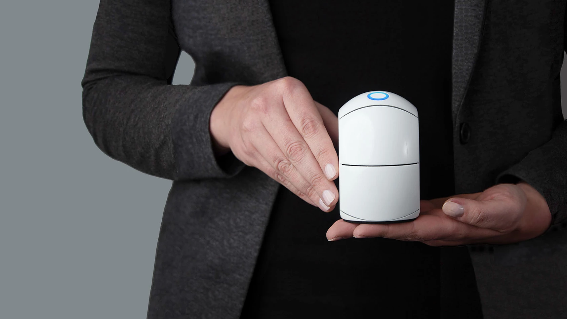
MAKING CLINICAL-GRADE BIOMARKER DATA EASILY AND QUICKLY ACCESSIBLE.

Slide 2
TRENDS
Healthcare decentralisation
Chronic diseases and increase in ageing population
Growing health interest
Notes:
Viruses and bacteria epidemic and pandemics are likely to appear again, in a smaller or larger scale and in different formats. Therefore, given our ability to provide diagnostics and prognostic solutions for decentral or home-use self testing, we see it as a part of our job to be ready.

Slide 3
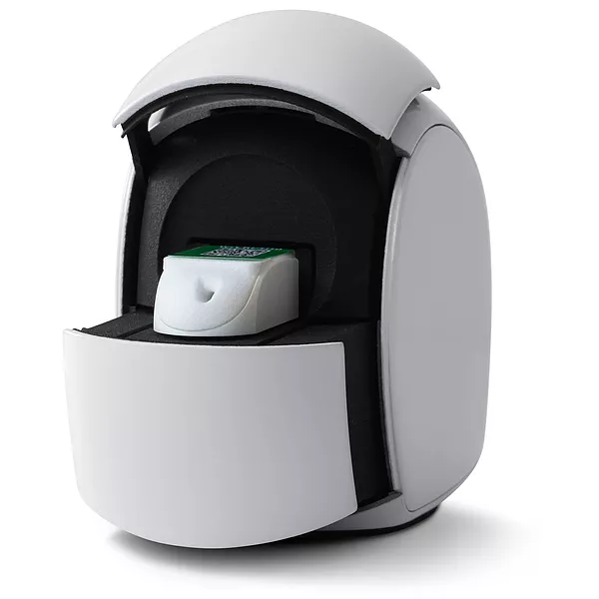
11 cm
SAY HELLO TO EGOO
A mobile test unit with disposable capsules and smart software for personalised diagnostics
Notes:
Viruses and bacteria epidemic and pandemics are likely to appear again, in a smaller or larger scale and in different formats. Therefore, given our ability to provide diagnostics and prognostic solutions for decentral or home-use self testing, we see it as a part of our job to be ready.

Slide 4
HOW IT WORKS
Easy sampling with a mouth swab or a droplet of blood
Advanced optics measures DNA/RNA/Protein biomarkers
Raw data is transferred to the cloud for immediate analysis
The app synchronizes all data and delivers the results
Notes:
Viruses and bacteria epidemic and pandemics are likely to appear again, in a smaller or larger scale and in different formats. Therefore, given our ability to provide diagnostics and prognostic solutions for decentral or home-use self testing, we see it as a part of our job to be ready.

Slide 5
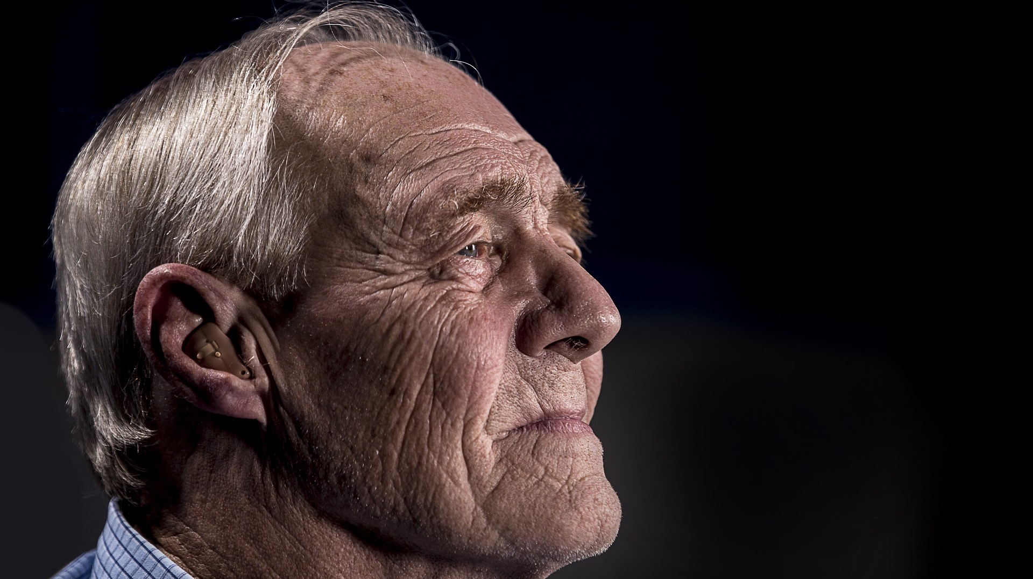
“I HAVE DIABETES TYPE II”
Kaj, 76

Slide 6
“MY MOM SAYS I HAVE PHE”
Gunnar, 2

Slide 7
“I WANT TO IMPROVE MY PERFORMANCE”
Christopher, 27

Slide 8
“I AM STRESSED OUT”
Olivia, 19

Slide 9
IMPORTANT QUESTIONS

Slide 10
WHAT HAS QLIFE BEEN FOCUSED ON THE PAST 12 MONTHS?
Bringing COVID PCR capsule to market
COVID sales +35 MSEK
Technical dossier for Egoo.Health platform (foundation for the platform)
Regulatory requirements (IVDR)
Software domentation (heavy)
Production validation (heavy)

Slide 11
WHAT ARE THE DEVELOPMENT STEPS THE NEXT 12 MONTHS?
CE-Protocols, validation and clinical trials CRP and PKU
Pilot productions (12.000 capsules per test to CE-mark)
Upgrade technical dossier
IVDR submission (6 months)
Market launch
R&D start on next biomarker

Slide 12
WHEN WILL QLIFE HAVE AN APPROVED HOME-USE TEST?
CRP = Oct 2022 – Mar 2023
PKU = Dec 2022 – May 2023

Slide 13
HOW MANY BIOMARKERS WILL QLIFE LAUNCH OVER THE NEXT 5 YEARS?
IMPORTANT: Fundamental platform approved
Realistical target 1-2 biomarkers/ per 18 months
5 years plan approx = 5-10 biomarkers approved for home-use
Investigating biomarker matrix

Slide 14
WHAT ABOUT COVID PCR HOME-USE TEST?
New market demand may open business case again – we are following opportunities as they arise
Prioritise our resources
Possibility for gaining external financing to continue

Slide 15
PRODUCTION VOLUMES 2021 STEADY INCREASE AND QUALITY INCREASE
Units | Product | Q1 | Q2 | Q3 | Q4
Target | Device / Capsule | 150 / 10.000 | 200 / 15.000 | 300 / 25.000 | 600 / 40.000
Actual | Device | 80 | 100 | 150 | 250
Actual | Capsule | 8.000 | 12.000 | 20.000 | 40.000
Production output to sustain sales and internal studies
Higher than expected ratio of capsule usage per device

Slide 16
CAPSULE 3-YEAR PRODUCTION PLAN
Current capsule production line is optimized to output of 20.000/month JANUARY Current capsule production line replicates and 2-ways shifts PLANNED Q1 22 Adding semi-auto functionalities upstart in new facility (cannot start in current facilities) to reach 150.000 month PLANNED 22 Projection on full automation plant runs parallel ON-GOING

Slide 17
DEVICE 3-YEAR PRODUCTION PLAN OUTSOURCED TO CONTRACT PARTNER
Expected to reach phase 5 in 2022

Slide 18
COOPERATION AIDIAN?
Status?
Can Qlife cancel the agreement if Aidian doesn’t reach the sales goal?
Which markets are you present in via Aidian today? Which are the most important markets?
Which clients and channels are Aidian focused on

Slide 19
HOW DO QLIFE SEE THE MARKET FOR HOME-USE BLOOD TESTING DEVELOP?
Many reports point in that direction
However, IVDR has made it more difficult
QLIFE is in a good position to become a firstmover

Slide 20
THE UPSCALING JOURNEY
1. PRODUCT READINESS | 2. BUILD-UP CLINICAL SALES | 3. MARKET-LEADING POSITION IN PKU GLOBALLY | 4. PAVE THE WAY TO CONSUMER HEALTH
CE-mark of core Covid-19 PCR virus biomarker test Receiving patent First 50 devices sold to Danish Infections Disease Agency Product roll-out on-going | Build KOL customer base: Hospitals, institutions, speciality fields Scale production to at least be able to support sales
Establish presence as preferred PKU
monitoring device
KOLs to use the Egoo.health platform
Data integrations with
healthcare systems
First PKU customers / user experience
Provide a range
of tests for health and well-being biomarkers
Build on our current network of COVID testing to establish presence across clinical retail settings
REVENUE
Build revenue and outsource device production
Go-to-market
Becoming ready for consumer retail
Expanding range of biomarkers
2020
2021
2022-2024
DONE

Slide 21
PROGRESS ON IP?
Danish Patent no. DK180348B1 issued.
PCT/EP2020/087510 filed on 21 December 2020 (under examination).
Danish Patent application no. PA 2019 01565.
PCT/EP2020/087539 filed on 21 December 2020 (under examination).
Worldwide protection

Slide 22
IS QLIFE INVIOLVED IN COVID LABORATORY TESTING?
Not focused on laboratory testing anymore
Laboratory testing has helped to build an agile company
Transition to Egoo.health

Slide 23
REVENUE TRANSITION
Revenue kSEK | 2021 | 2021 | 2021 | 2021
 | Q1 | Q2 | Q3 | Q4
Revenue | 11.176 | 10.482 | 5.871 | ?
Dip in revenue due to transition
Q1 – Q2 Laboratory sales
Q3 Egoo.health platform sales
Q4 Strong – and only - focus on platform sales

Slide 24
QLIFE SUMMARY
IVDD to IVDR shift has taken focus and resources
Foundation for the future establised
Transition from laboratory to Egoo.health DONE
Company well positioned to be FIRST MOVER

Slide 25
THANK YOU!

